Slide 1
EMed-a complete pharmacy at your door- step
Team Delta
Rishika Kandrigal
Vishnu Priya Vulichi
Md Ariful Hasan
Ganesh Gundekarla
Shabana Syed
Vivek Nelluri
Pranav Chalasani
Ajay Kumar Reddy Sammeta
CSCE 5430 : Software Engineering – Deliverable 1

Slide 2
Project Overview
The eHealth website aims to bridge the gap between patients and health care Facilities. It provides a seamless interface with all the information a user needs such as Doctors' appointments, blood donor information, and ordering medicine online. MongoDB will store all patient and healthcare facility data and HTML, CSS, and JavaScript used to improve the user experience.

Slide 3
Key Features
• User Authentication & Registration.
• Medicine Browsing & Purchase.
• Doctor Profiles and Appointment Scheduling.
• Blood Donation and Emergency Requests.
• Admin Control Panel.
• User-Admin Communication.
• Payment And Checkout Options.
• SEO-Optimized Category Pages.
• Remote Health Monitoring.

Slide 4
Environment (Frontend)
Web structuring will be done using HTML5
Styling and layout of the page using CSS.
Interactive functionality will be added to HTML5 elements through ‘JavaScript’.
React.js framework to build a dynamic and interactive interface which uses the structure provided through HTML5.
React.js for state management.
PayPal SDK (client side) integration functionality provided by PayPal.
Material UI or Bootstrap for UI.
Axios for HTTP requests to interact with API’s.
React Router- a library for navigation.

Slide 5
Environment (Backend)
Node.js with Express.js frameworks for backend development.
JSON web tokens to be used for authentication.
PayPal SDK.
Security will be integrated through bcrypt.js, Helment.js.
Nodemailer a Node.js for simplifying the process of sending emails.
Database language:
Managing and storing data will be done in a flexible way like JSON-like format through MongoDB.

Slide 6
Team Introduction
Backend Development(Vishnu Priya): Developing the server-side logic , database schema and API's integration to implement the business functionalities by ensuring that data integration and processing go smoothly and effectively.
Project Management Lead (Rishika Kandrigal): Managing the team, communicating with all the teammates, scheduling meetings, tracking the project progress, monitoring and setting upcoming milestones, documenting, creating webpage and styling , checking whether everything going well, encouraging and motivating to complete the work fast.
Configuration Management Lead (Vivek Nelluri): Control and management of the configuration management process and makes sure that application modifications are regulated, recorded, and in line with objectives.
Documentation Lead (Ajay Kumar Reddy Sammeta): Ensure all the documentation is clear, accurate and up-to-date. Collaborate with the team.
Risk Analysis Lead (Md Ariful Hasan): As a risk analyst, I identify and evaluate potential risks in our software project to address issues before they affect our outcomes. I assess risk probabilities and impacts to ensure we implement strategies that keep the project stable and successful.

Slide 7
Testing Lead(Shabana Syed): Defining the test strategy and planning, managing the test environment setup, Selecting testing tools, tracking testing progress, Post-release testing, and validation.
Demo and Presentation Lead (Pranav Chalasani): Leading the demonstration and presentation efforts by ensuring seamless coordination between team members for a clear, compelling delivery. Responsible for creating presentation content, conducting rehearsals, managing audience engagement, and ensuring that all aspects of the project are communicated effectively during demonstrations.
Requirements and Frontend lead (Ganesh Gundekarla) : Overseeing of alignment of the requirements of the project and making sure that they align with our project development , also in parallel ensuring that there is a complete collaboration between the requirements and the frontend part in order to get a successful project outcome .

Slide 8
Risk Analysis and Management
Risk Analysis:
Technical Risks:
Integration Issues, Database Scalability, Security Vulnerability
Operational Risks:
System Downtime, User Adoption and usability, Compliance and legal Issues
Project Management Risks:
Scope Creep, Resource Availability, Budget Overruns
External Risks:
Vendor Reliability, Regulatory Changes, Market Competition.

Slide 9
Risk Analysis and Management
Risk Management:
• Hold weekly or biweekly stand-ups to cover risky areas such as security, payment issues, site downtime, and compliance.
Monitoring Risks
Data Security
Payment Gateways.
Emergency features
Key performance indicators
Uptime
Transactions success
User Satisfaction.
Contingency Plan :
Frequent system audits and stress assessments will be carried out to detect and mitigate any faults, particularly during peak demand or crises.
Data encryption, multi-factor authentication, and secure payment channel protects against cyber threats and unauthorized access.

Slide 10
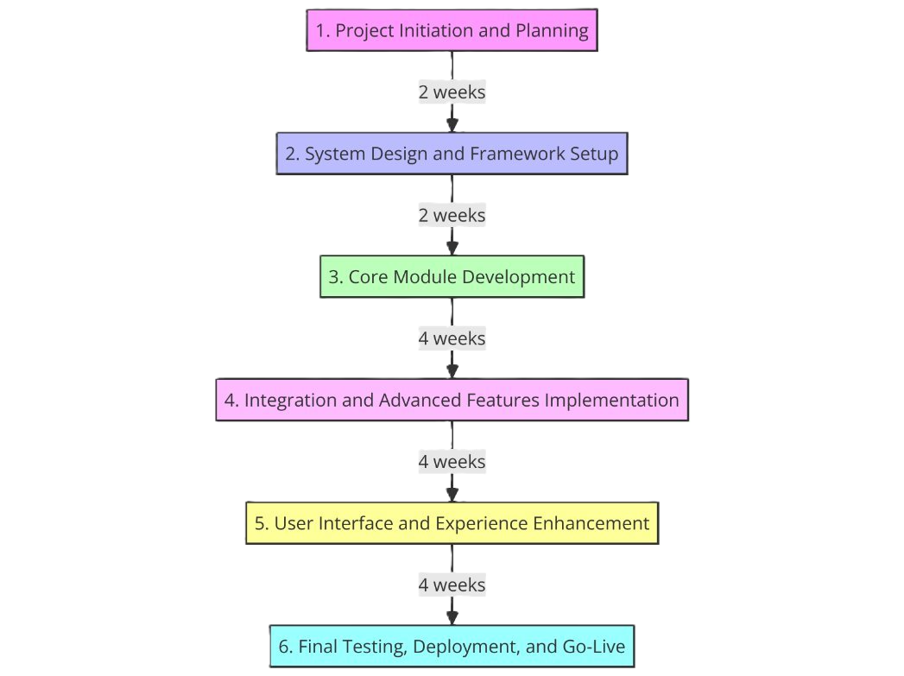
PROJECT TIMELINE

Slide 11
Conclusion
Healthcare Accessibility and Efficiency:
The platform facilitates access to healthcare, by offering online system for managing emergency responses, making doctor appointments, and purchasing medications.
Additionally, it ensures the efficient and safe handling of health information, enhancing consumer ease and satisfaction.
Comprehensive Features and Administrative Support:
The platform provides a comprehensive healthcare solution with features like user registration, Doctor Profiles & Appointment Scheduling, Medicine search & Purchase, payment & checkout, real-time assistance, and management tools.
Optimized services and smooth operations are ensured to be provided to both administrators and users.

Slide 12


